Slide 1
2022
Holiday Planner
HOLIDAY PLANNER

Slide 2
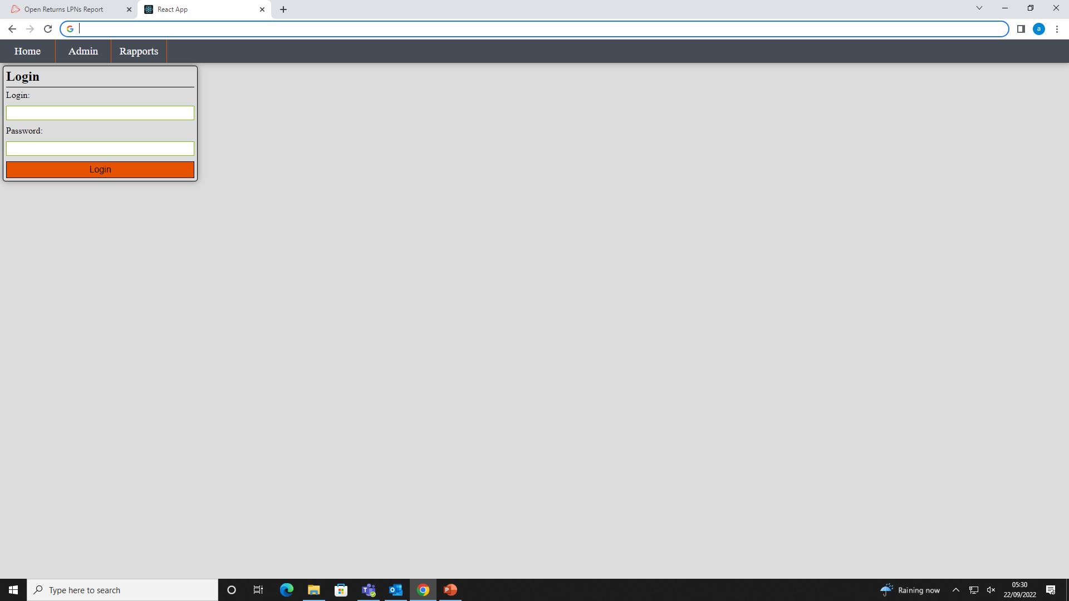

HOLIDAY PLANNER
1. To get access to app please type in address: http://192.168.154.213:3000 (1),
then type in login : ……and password:….,
then click ‘Login’ button.

Slide 3
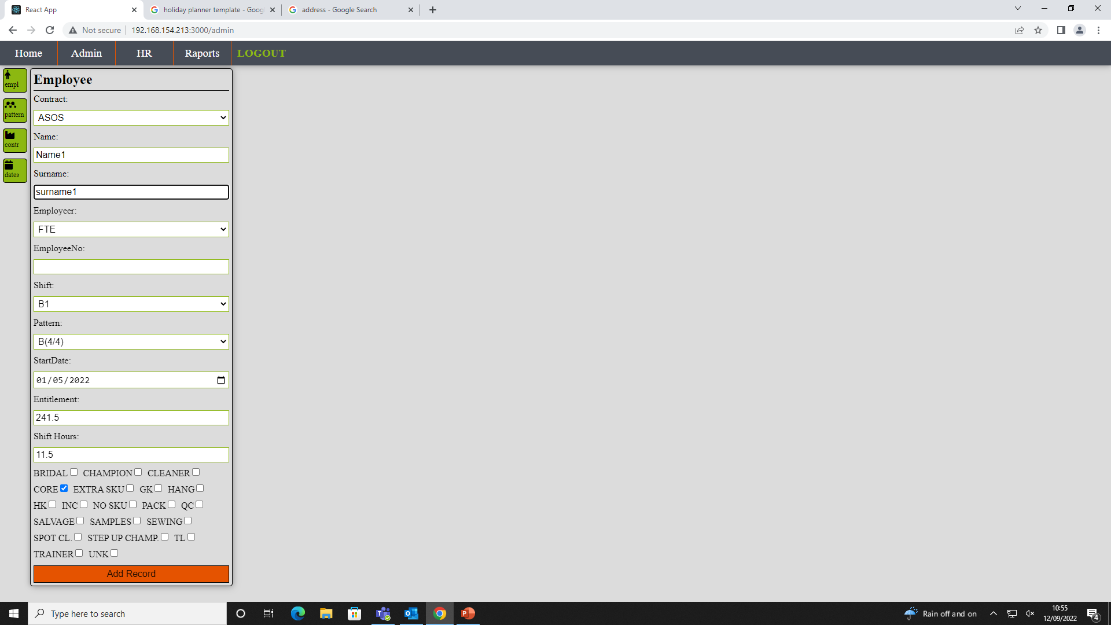
HOLIDAY PLANNER
2. If you click ‘Admin’ button you should be able to see employee update form. Please fill in all inputs (‘Employee No’ can be left blank if it is unknown). Please start from picking ‘Contract’. At the bottom of form you need to click all the jobs that operative is trained for. Once form is done please click Add Record button.
If it is FTE please make sure that StartDate is taken from 2022-2023 HOLIDAY LOG in HR Folder and not from validation list.
Once all operatives from your shift are updated you can start to update holiday calendar.

Slide 4
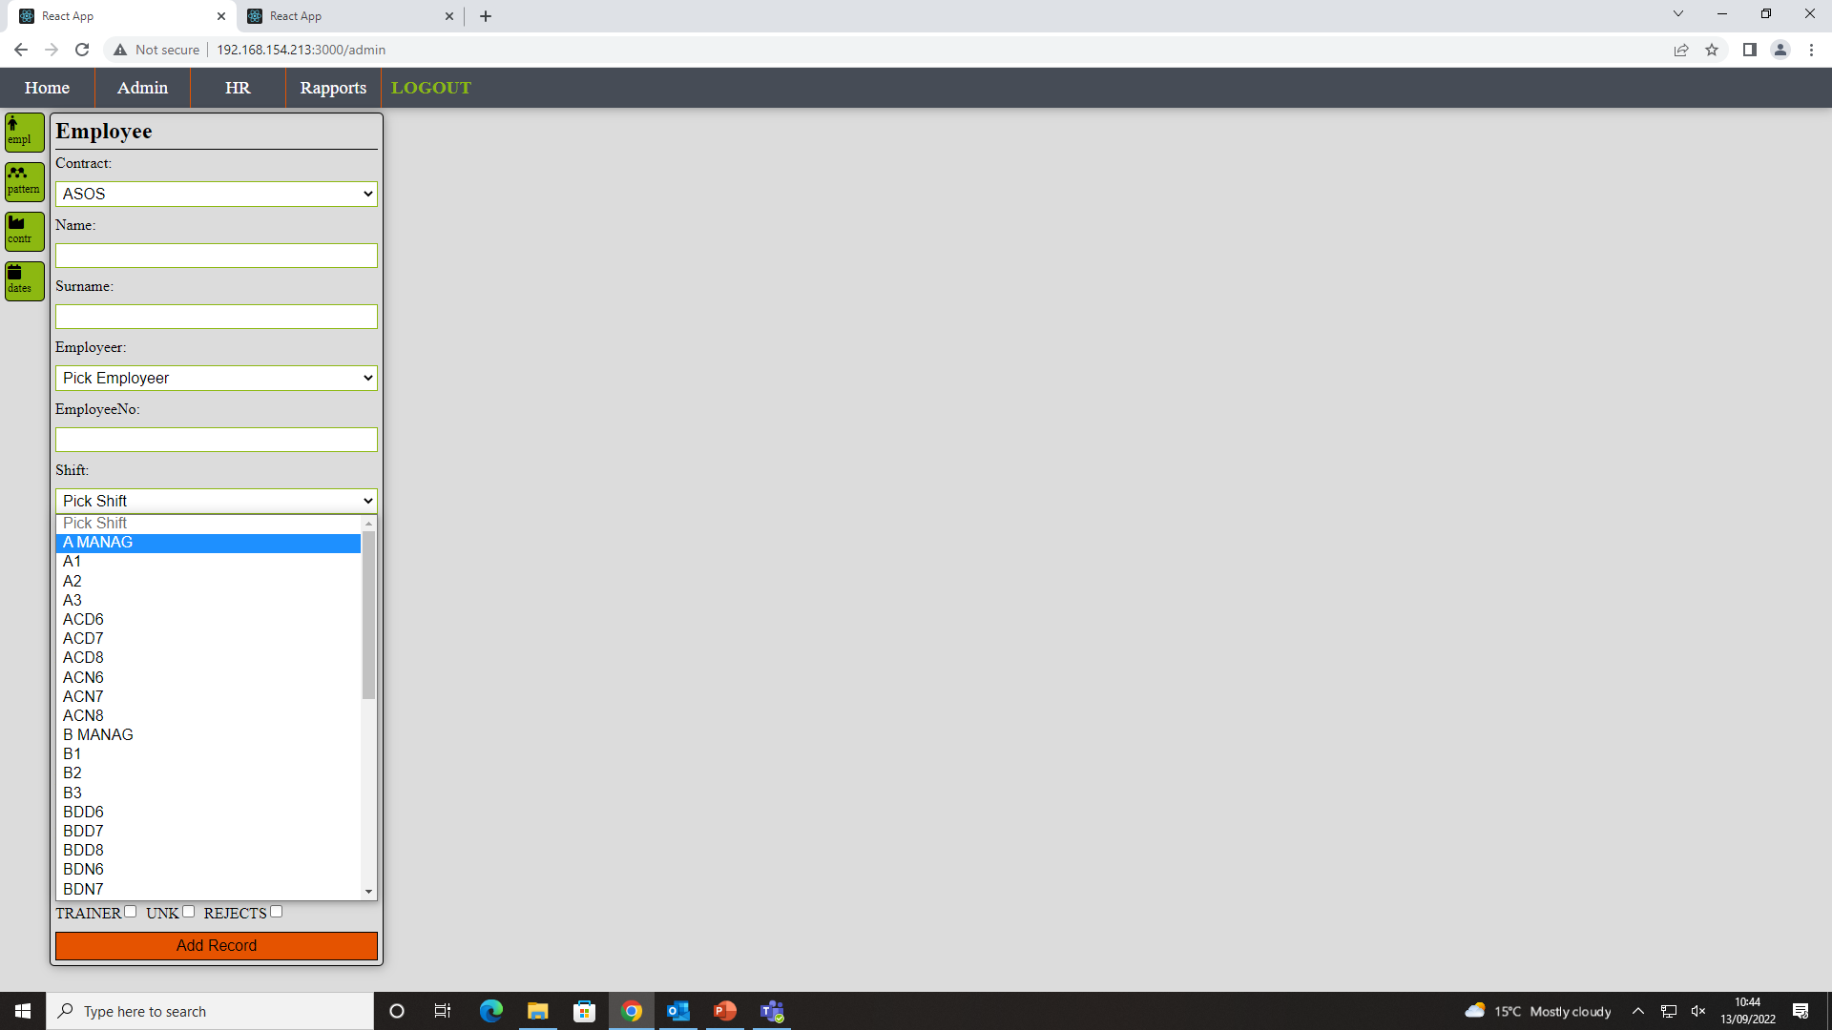
HOLIDAY PLANNER
2a. There is specific convention for shift naming i.e.:
A,B - regular shift,
ACD – AC days, BDN – BD nights,
there are Mangers Group for each shift for Champions, TL and DSM, so instead adding i.e. TL to A1 please pick up A MANAG.

Slide 5
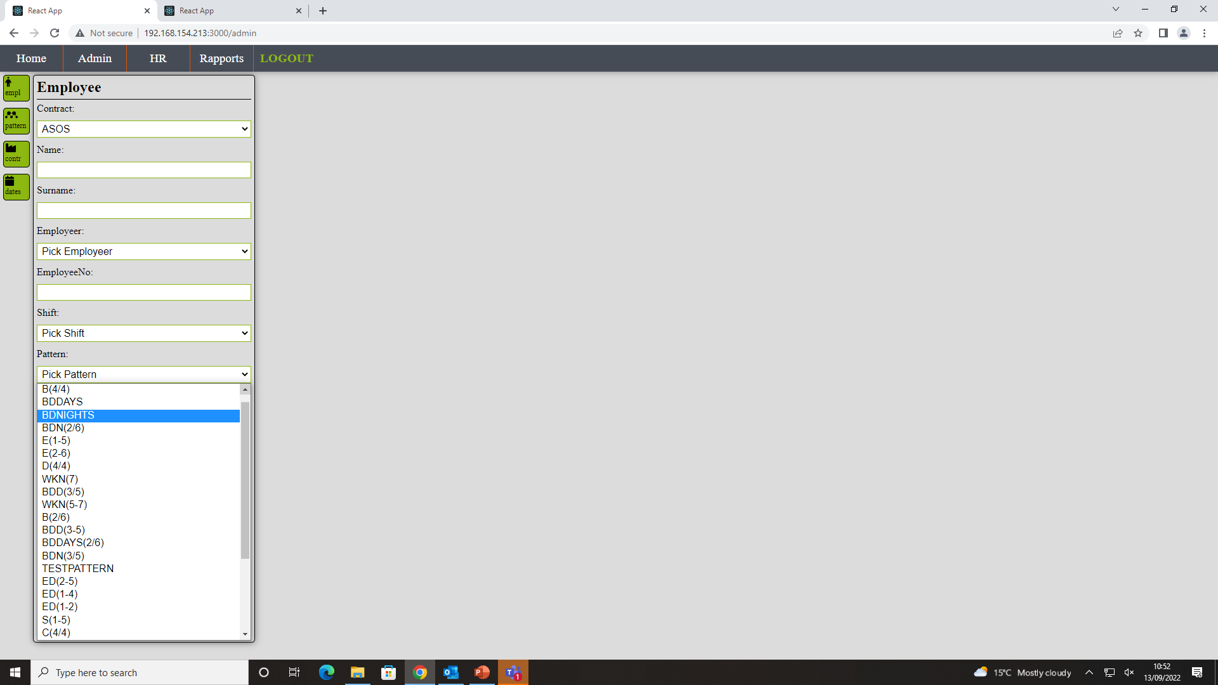
HOLIDAY PLANNER
2b. There is also specific convention for pattern naming i.e.:
BDN – BD nights,
B(4/4) – B shift 4 days on 4 days off
E(1-5) – E shift from Mon till Friday
WKN(7) – weekly - Sundays nights
2/6 – number days on/off: 2 on 6 off
2-5 - days from - till : from Tue till Fri
2,3 – days of week: Tue, Wed
2c. Click ‘Admin’ and ‘Patterns’(1) to see Pattern details. If there is no pattern you need please send email so I will be able to create it.

Slide 6
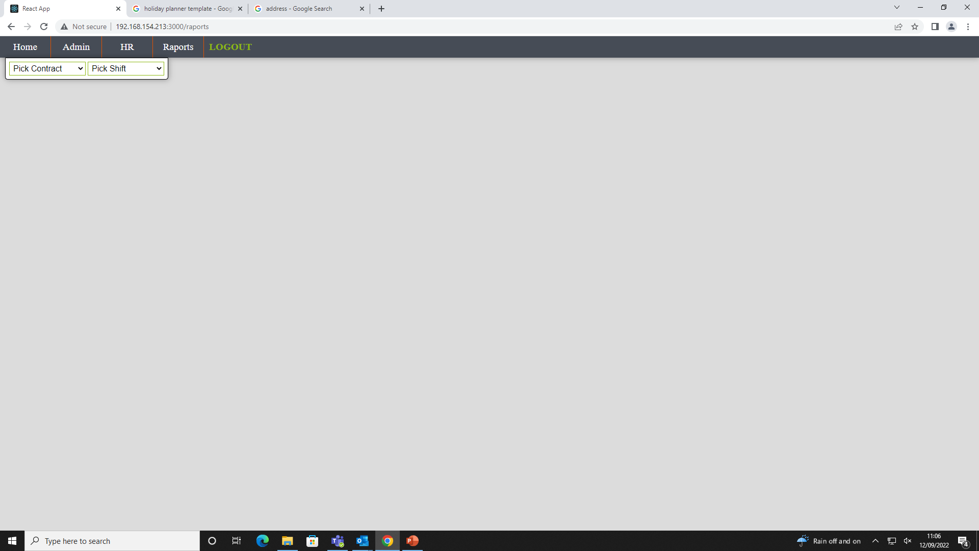
ASOS Sie Chart
HOLIDAY PLANNER
2. If you click Rapports button you should see that page. Please pick Contract in Pick Order and your shift in Pick Shift Inputs.

Slide 7
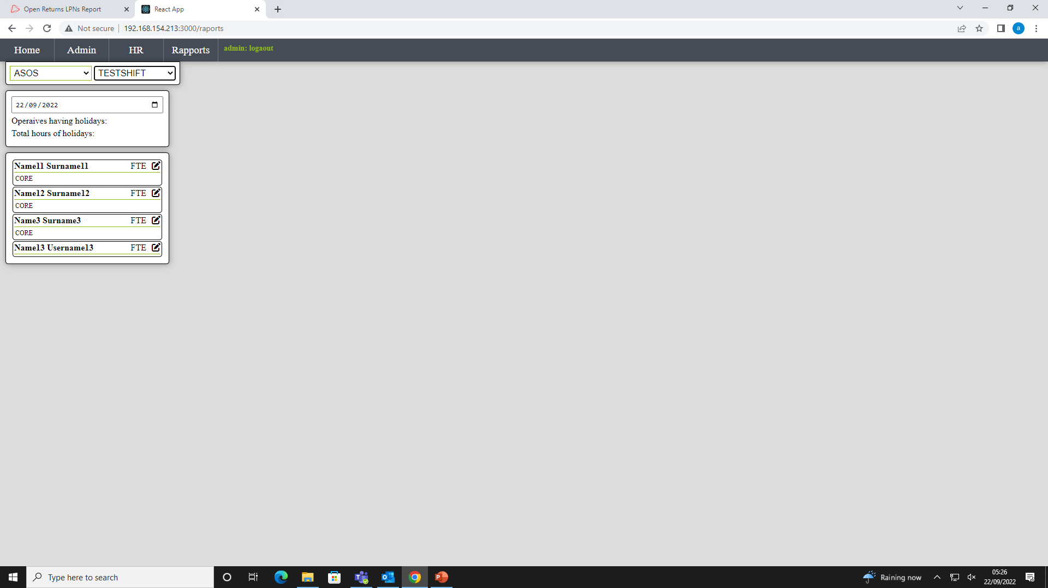

HOLIDAY PLANNER
3. you should see all operatives from your shift.
All operatives in green means that they having holiday at that day.
Yellow is aaup,
Pink is absence.
If you click calendar icon (1) you can choose different date and it will show staff on holidays or absent on that day.
To book holiday you have to click “pen” icon (2).

Slide 8
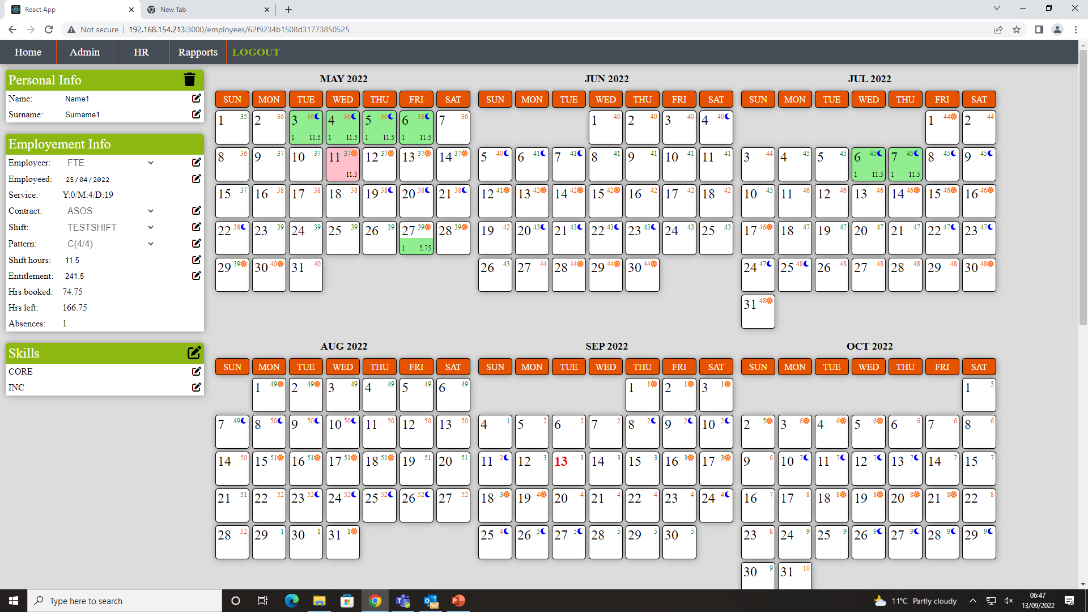
HOLIDAY PLANNER
4. You should be able to see operative holiday panel. On the left side there are operative details (details can be updated by clicking “pen” icon -1), on right there is calendar where holiday, absences and aaup are booked.

Slide 9
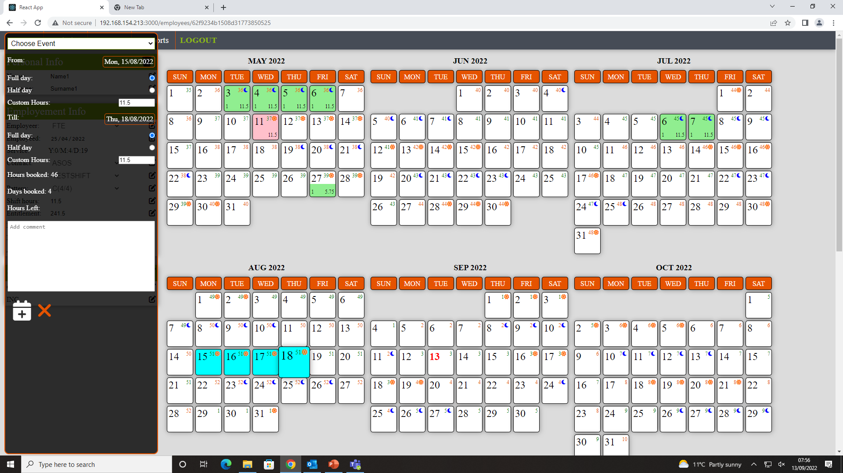



HOLIDAY PLANNER
5. To book holiday you have to click first and last day of holiday on calendar(4). Once you click first day you will see booking panel on left side. You can book full days or half days (3) and update them by clicking ‘calendar’ icon (1). Selected days will change colours to blue (4). Before you update event to database please select event name (2).

Slide 10
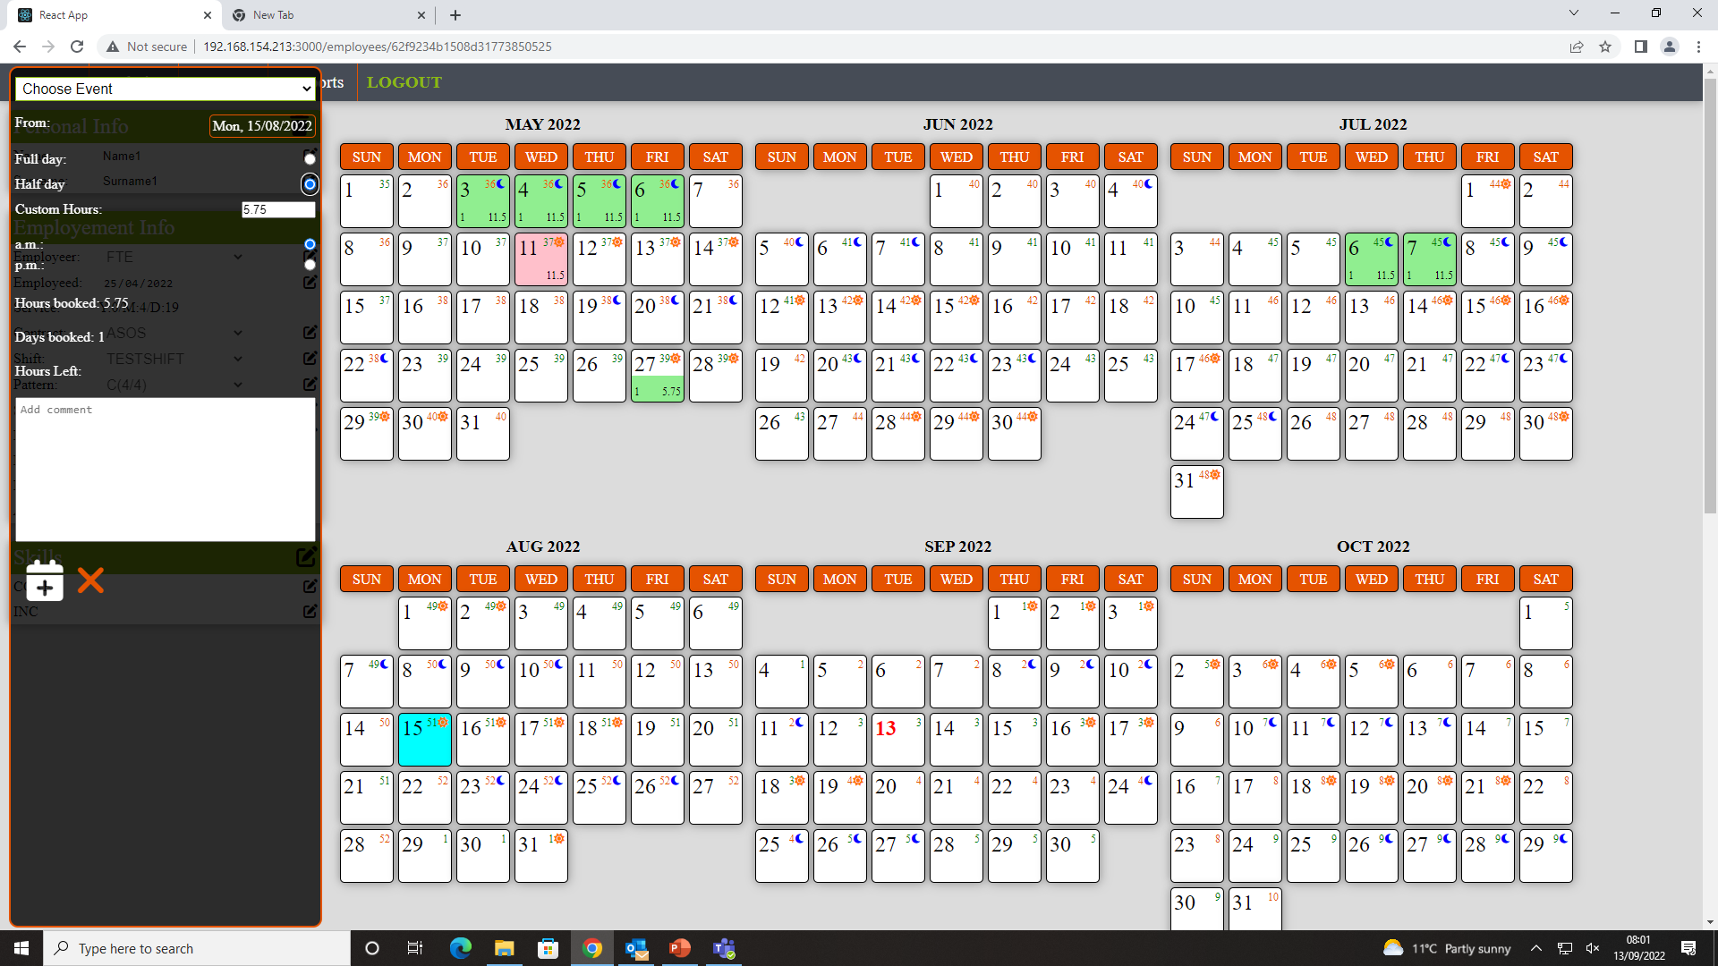


HOLIDAY PLANNER
5a. Booking half day. To book half day please click half day (1). If it is one day only you will be able to choose a.m. or p.m. (2).

Slide 11
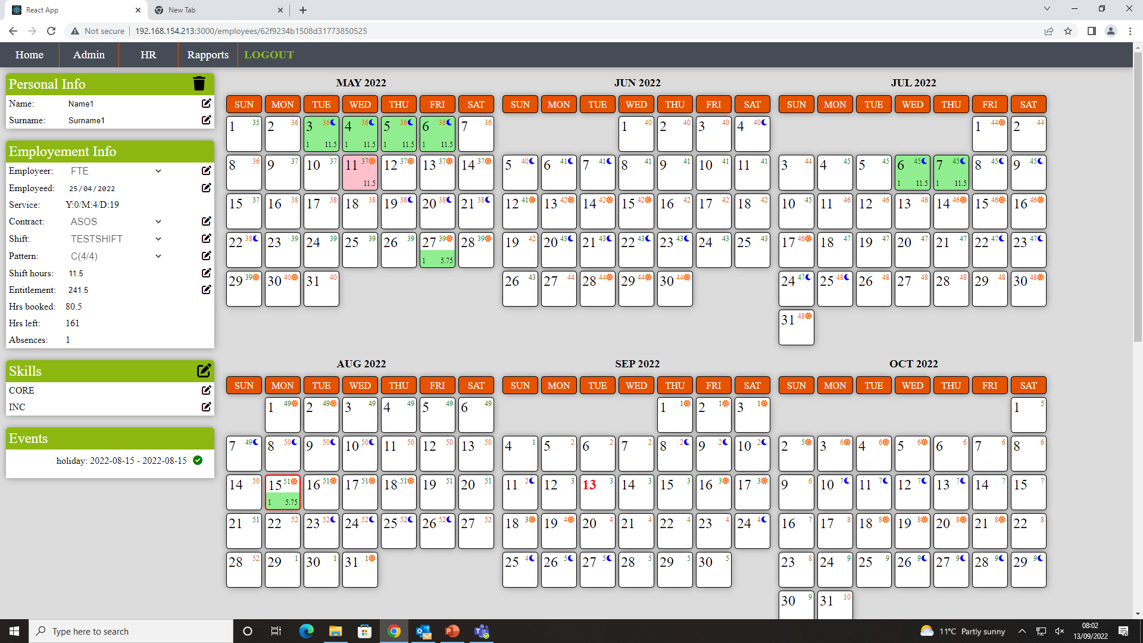

HOLIDAY PLANNER
5b. Half day morning booked (15.08.2022). Once holiday is booked please click ‘confirm’ icon in ‘Event’ tab(1). In future it will be only HR who will be able to confirm events but because first we have to update database up to date it need to be done every time event has been booked.

Slide 12
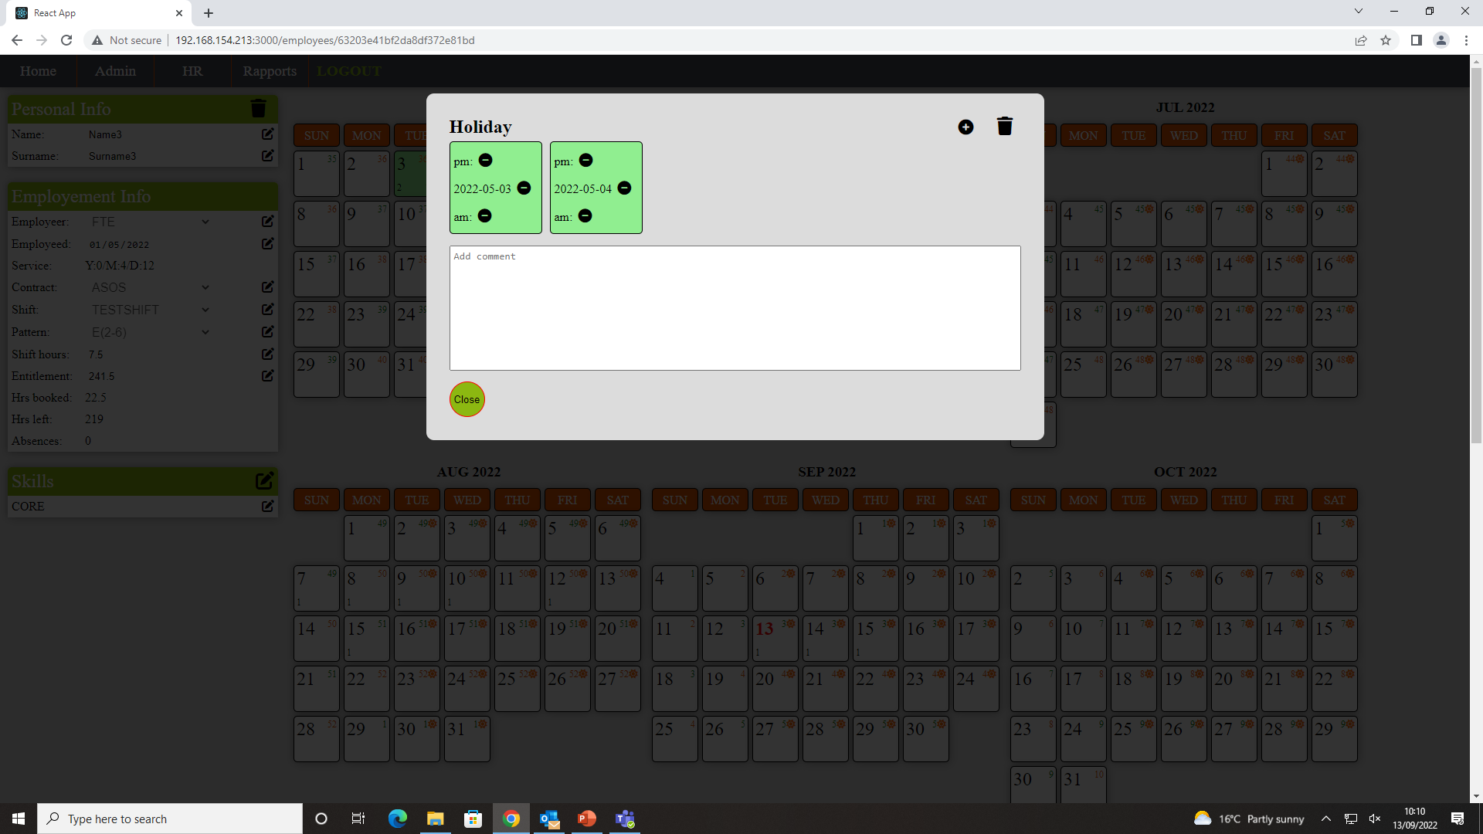

HOLIDAY PLANNER
6. To Cancel holiday you have to click date on calendar and edit panel will show up. By clicking ‘minus’ icon you can cancel half a day .am./p.m or full day.

Slide 13
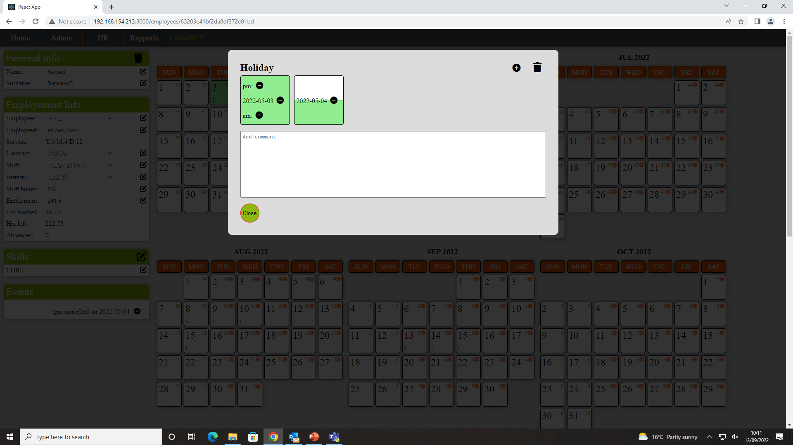

CLIPPER HOLIDAY PLANNER

Slide 14
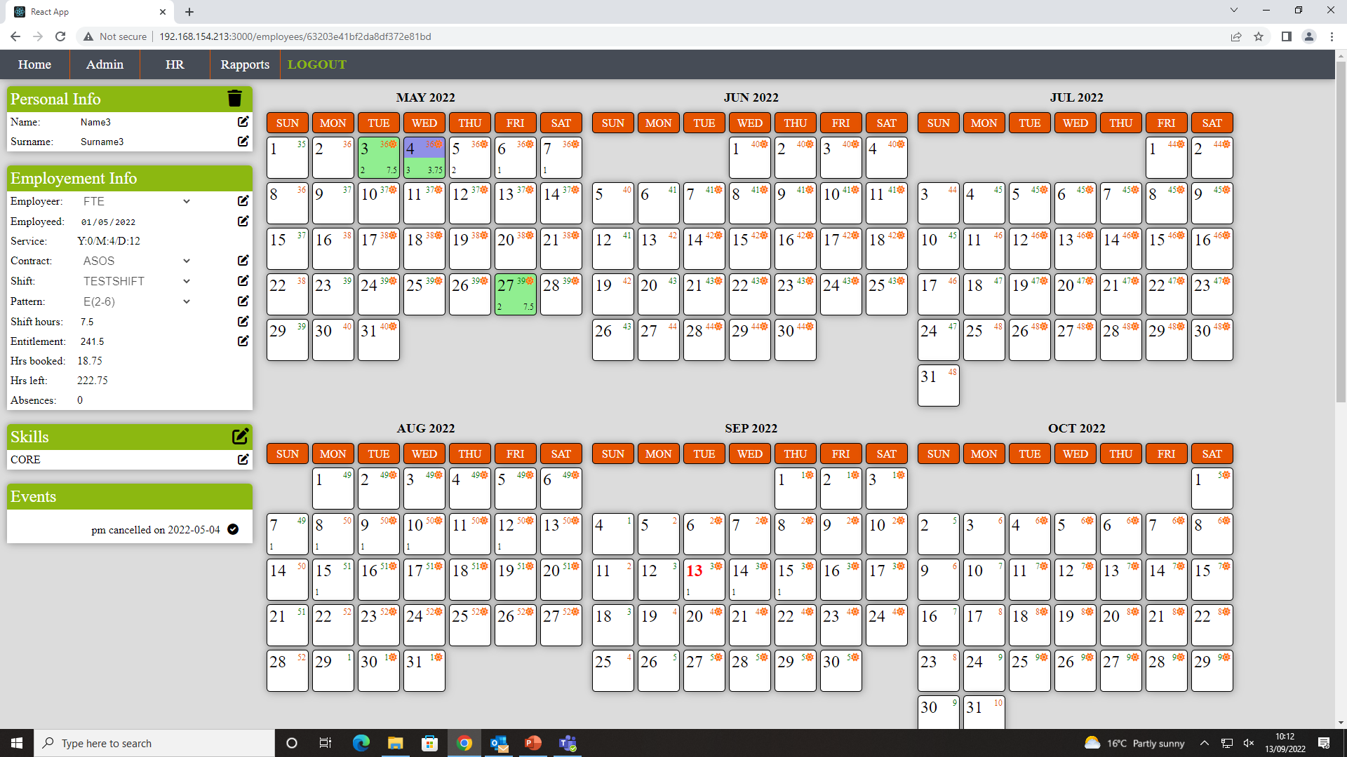

CLIPPER HOLIDAY PLANNER
6b. In example below half a day afternoon was cancelled (blue part of day rectangle). It is also notified in ‘Events’ tab. - it also need to be click (in Future only HR will be able to do so).

Slide 15
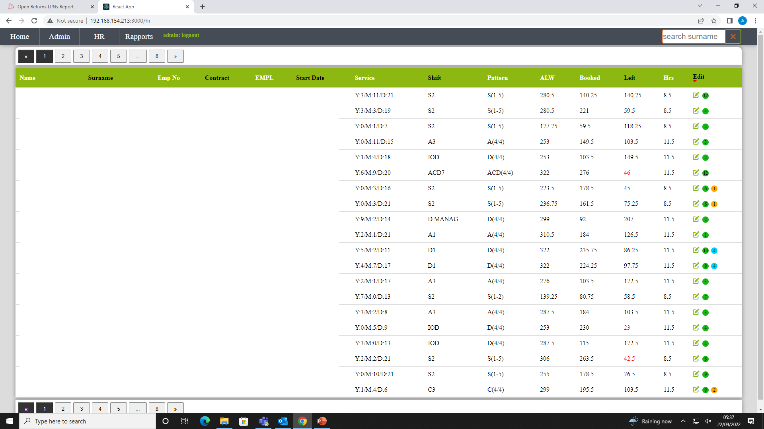




CLIPPER HOLIDAY PLANNER
7. HR page shows all FTE.
Any booked events will be visible on the left side till they are confirmed (1).
If you click `Edit` it will filter employees with events tbc.
All record are sorted by default by name but it can be change to : contract, start Date, shift hours Left by click headers (2).
To search surname please use search bar (3)

Slide 16
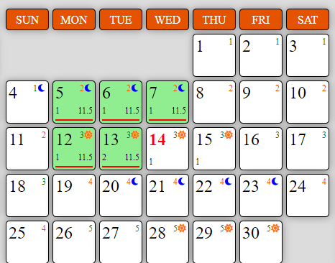
CLIPPER HOLIDAY PLANNER
8. Calendar legend
Sun icon – day shift Crescent icon – night shift
Week No
Red line means comment
Number of operatives from shift having holiday that day

Slide 17
CLIPPER HOLIDAY PLANNER
9. Holliday planner is still in development mode so certain features might change. There is already more advanced ‘Rapport’ page developed but not implemented. Priority is to update database, fix minor error that has been noticed and fully develop login system. Finally everybody will get individual login and certain app activities (update, delete and so on) will be recorded.
If you notice anything that could be done better or there is something that would improve app please let me know
Kind Regards,
Marek Firsowicz

